Slide 1



INDIVIDUAL
PRESENTATION
AUGUST 1, 2024

Slide 2

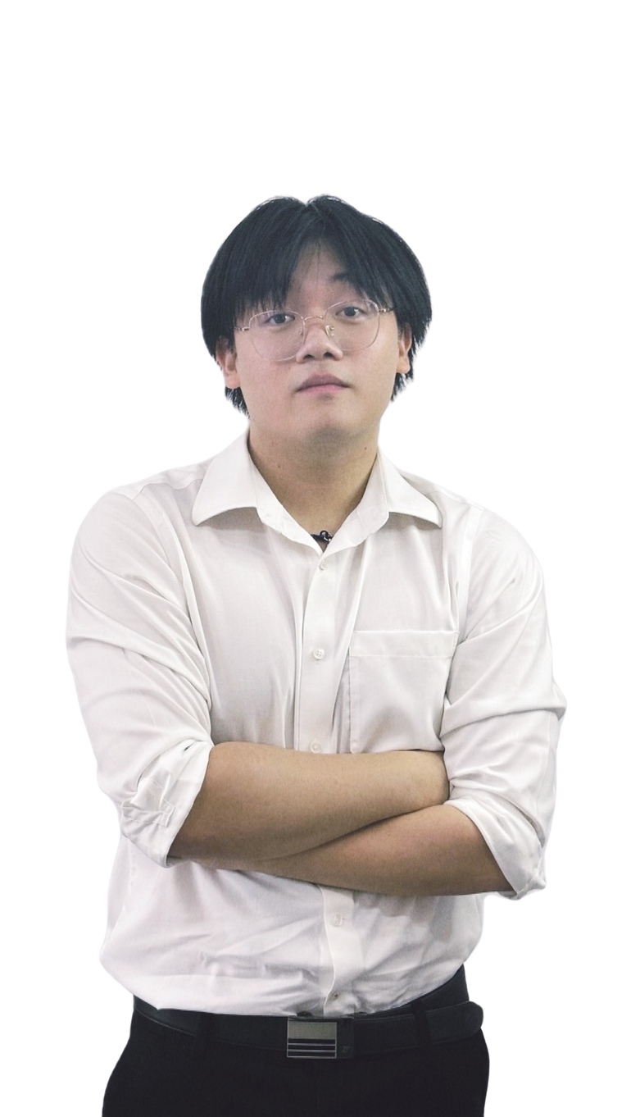
Greeting
Name: Supakrit Nithikethkul (Krit)
Position: Developer
Department: SKY Team
Location: 9th floor PHP building

Slide 3

Table Of
01
ROLE AND RESPONSIBILITIES
04
ACHIEVEMENTS AND HIGHLIGHTS
Content
Presentation
(12 minutes)
+ Q&A
(3 minutes)
02
KEY PROJECTS AND CONTRIBUTIONS
05
MENTORSHIP, TEAM AND COLLABORATION
03
LEARNING AND DEVELOPMENT
06
FEEDBACK AND RECOMMENDATIONS

Slide 4





1. Role and Responsibilities
Brief description of the Department
legacy system
new system
Spacific tasks and projects undertaken
Develop API application (Backend developer)
System Assistance
Documents
Programming Assistance
Application
Quality Assistance
Learning Deployments (DevSecOps team)
run docker, run pod and add secrets(K8S)
Create Jenkins pipeline
Day-to-day responsibilities
Daily scrum meeting
Brief from SA

Slide 5


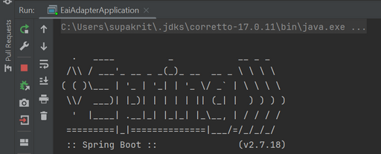





2. Key Projects and Contributions
Backend developer
Description
Objectives
Personal contributions
IntelliJ IDEA
Refactor the legacy code to the new design application using Java Spring Boot framework.
Postman
Application
Database
Outcome and impact
pass the “sit” test
new feature added
On developing
Sourcetree
DBeaver
Version control

Slide 6








2. Key Projects and Contributions
DevSecOps
Description
Objectives
Personal contributions
Run docker locally in machine 195
Create data pipeline in Jenkin
Outcome and impact
Understand the system and how the application deploys
Azure cloud
APIM
APIM GUI
Nexus
Docker
Kubernetes

Slide 7


3. Learning and Development
Skills Acquired
TECHNICAL SKILL
SOFT SKILL
Application development
Application architecture
System architecture
Deployment Tools
Read the documents
Ask the questions
Inform the problems
Write the issue posts.

Slide 8


3. Learning and Development
Challenges and Solutions
SPACIFIC CHALLENGES
SPACIFIC SOLUTION
complex system architecture
limited permission
a lot of product line, order type, and application name
a lot of spacific word such as Phoenix, Lego,
asking the questions
asking or writing for privilege user
repeat the brief recording video.
asking for the infra-dictionary

Slide 9
4. Achievements and Highlights
Major Achievements
Spacific accomplishments
Recognition and feedback from supervisors or colleagues

Slide 10
4. Achievements and Highlights
Memorable Moments
Personal moment
Positive experiences

Slide 11
5. Mentorship, team and collaboration
ROLE OF MENTOR(S)
GUIDANCE AND SUPPORT RECEIVED
INTERACTION WITH TEAM MEMBERS
You can use presentation
media in the form of a
combination of images,
videos, graphics, tables
and others.
You can use presentation
media in the form of a
combination of images,
videos, graphics, tables
and others.
You can use presentation
media in the form of a
combination of images,
videos, graphics, tables
and others.

Slide 12


6. Feedback and Recommendations
Experience with the Internship Program
OVERALL IMPRESSION
POSITIVE ASPECTS
You can use presentation
media in the form of a
combination of images,
videos, graphics, tables
and others.
You can use presentation
media in the form of a
combination of images,
videos, graphics, tables
and others.

Slide 13


6. Feedback and Recommendations
Suggestions for Improvement
AREAS WHERE THE PROGRAM COULD BE ENHANCED
PERSONAL RECOMMENDATIONS
You can use presentation
media in the form of a
combination of images,
videos, graphics, tables
and others.
You can use presentation
media in the form of a
combination

Slide 14

Expression of Gratitude
Thanking the company, team, and mentor(s)
THANK YOU
This sentence contains information
related to the title

